Slide 1
Section 106 Consulting Parties Meeting
December 11, 2017
Tim Barry, Louisville Metro Housing Authority
Gretchen Milliken, Louisville Metro Government
Jeana Dunlap, Louisville Metro Government
Cynthia Elmore, Louisville Metro Government
Cinder miller, gray & Pape, cultural resources

Slide 2
VISION RUSSELL Governance Structure
Louisville Metro Housing Authority
(Lead Applicant)
Louisville Metro Government
(Co-Applicant)
Implementation Team
Lead: Louisville Metro Housing Authority
Housing: McCormack Baron Salazar
Arts and Cultural: LCCC
Neighborhood: Louisville Metro Government / Louisville Forward
People: Urban Strategies
Education: Jefferson County Public Schools
Russell
Neighborhood Association
Coordinating Committee
Residents, Partners & Community Stakeholders
Service Provider Network
Workforce & Wealth Building Opportunities

Slide 3
A.D. Porter & Sons Funeral Home - African American Initiative - Asbury Chapel AME Church - Baptist Tabernacle Baptist Church - Baptized Pentacostal Church of Holiness - Beecher Terrace Residents - Bellarmine University - Blue Sky Advisors - Bingham Fellows - Bridge Kids International – Byck Elementary School - Carlton Brown (Housing Design) - C.E. & S. Foundation - Central Baptist Church - Center for Health Equity (LMG) - Center for Neighborhoods – Central High School - CLeaRly Stated Communications (Public Relations and Communications) - Choose Russell - Church of the Merciful Savior - Church Building and Loan Fund - Cities United - Civic Consultants, Inc. - City Properties Group - Community Coordinated Childcare/4C - Community Ventures Corporation – Coleridge-Taylor Montessori Elementary School - Develop Louisville (LMG) - ElderServe Inc. - EJP Consulting Group, LLC (Lead and Planning Coordinator) - First Samuel Baptist Church - Fifth Third Bank – Goody Clancy (Housing Design and Neighborhood Planning) - Greater Bethel Star Apostolic Church - Greater Nazarene Baptist Church - Greater Salem Baptist Church - Guiding Star Baptist Church - Habitat for Humanity of Metro Louisville - Hughlett Temple AME Zion Church - Humana - Housing Partnership Inc. - Jefferson County Board of Education - Jefferson County Public Schools - Joshua Tabernacle Missionary Baptist Church – Kentucky Center for African American Heritage - Kentucky Science Center - KentuckianaWorks / KYCC - Legal Aid Society - Liberty Temple - Local Interest Consulting - Louisville Affordable Housing Trust Fund - Louisville Alderman (former) - Louisville Central Community Centers - Louisville Free Public Library - Louisville Grows - Louisville Metro Council Members (former and current) - Louisville Metro Housing and Community Development - Louisville Metro Housing Authority (Board of Directors and Staff) - Louisville Metro Parks and Recreation - Louisville Metro Office of Neighborhood Planning and Preservation - Louisville Metro Police Department - Louisville Metro Public Health and Wellness - Louisville Metro Public Interest Broker - Louisville Metro Safe & Healthy Neighborhoods - Louisville Metro Solid Waste Management - Louisville Metro Planning and Design Services - Louisville Metro Office of Sustainability - Louisville Urban League - Kentucky Center for African American Heritage - Metro United Way - Moore Temple Church of God in Christ - Mt. Lebanon Missionary Baptist Church - Mt. Pilgrim Missionary Baptist Church - Neighborhood Planning and Preservation Kentuckiana - New Directions Housing Corporation - New Life Celebrations Christian Center - Neighborhood Outreach Worksers: Julia Robinson - Jackie Floyd - Latasha Moore - Vachel Hudson - Neighborhood Place - New Roots - NIA Center - Office Environment Company – Old Landmark Church of God - OneWest - Park Duvalle Community Health Center - Phillipean Church - Phillips Chapel AOH - Plymouth Congregational United Church of Christ – Poe Companies - Quinn Chapel AME Church - Reimage - Roosevelt Perry Elementary School - Sickles Inc. Realty - Simmons College - Smoketown Family Wellness Center - Spillman Memorial Church - St. James Baptist Church - St. Luke Missionary Baptist Church - St. Peters United Church of Christ / Molo Village Community Development Corporation - Sweet Peaches - The Beech - Transit Authority of River City - The CT Group - Telesis Corporation - YouthBuild Louisville - Valbridge Property Advisers (Market Study) - University of Louisville College of Education - University of Louisville College of Human Development - University of Louisville Institute for Sustainable Health and Optimal Aging - University of Louisville School of Public Health and Information Sciences - University of Louisville Kent School of Social Work - West Chestnut Street Baptist Church - Wheatley Elementary School - YMCA of Greater Louisville - Zion Baptist Church - Zimmerman/Volk, Inc. (Market Segmentation) - 28th Street Baptist
3
WHO’S INVOLVED
Notes:
Question is more Who’s not involved?

Slide 4
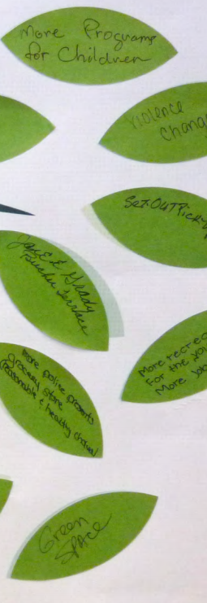
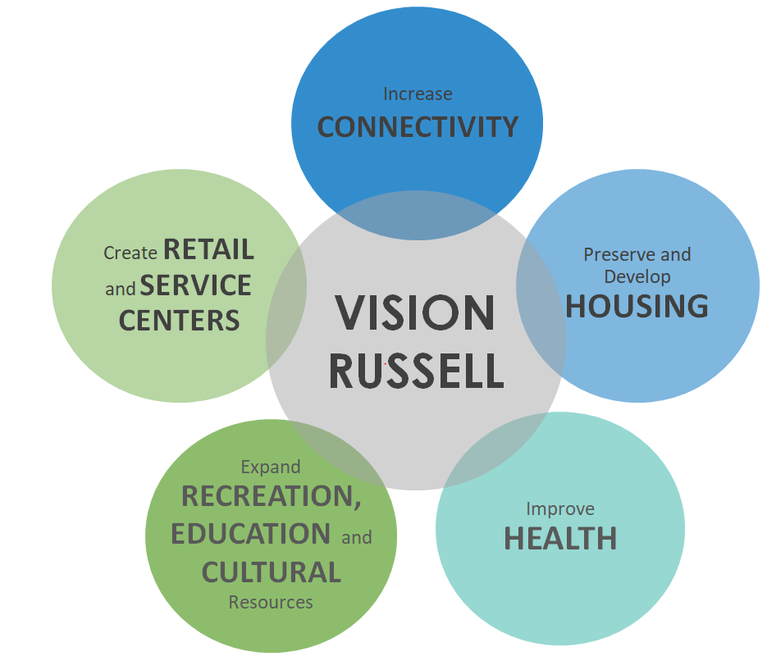
Project Overview
People
Housing
Education
Neighborhood

Slide 5
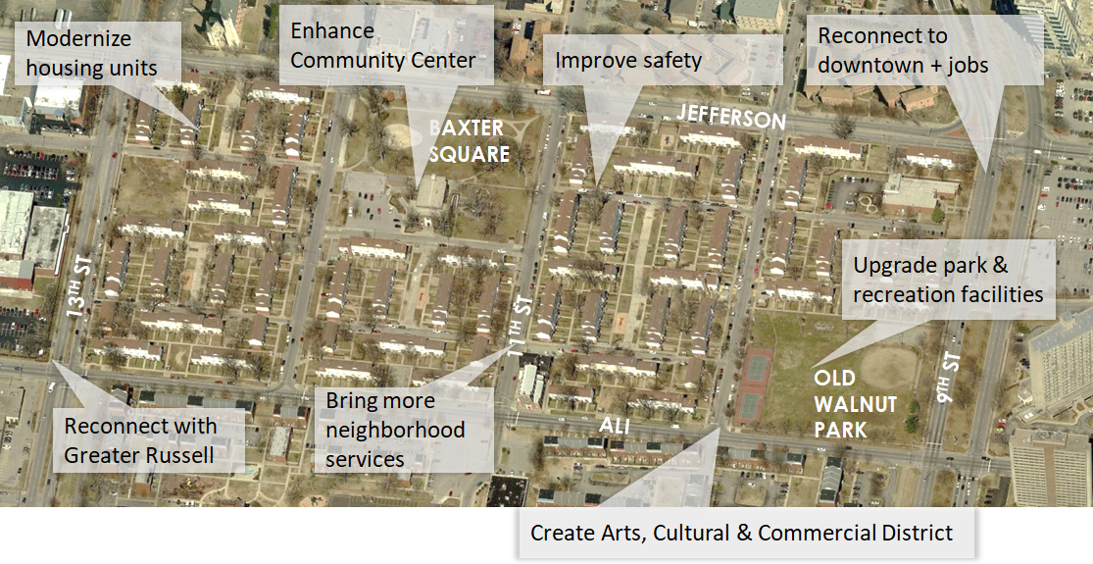
Need for the Project

Slide 6
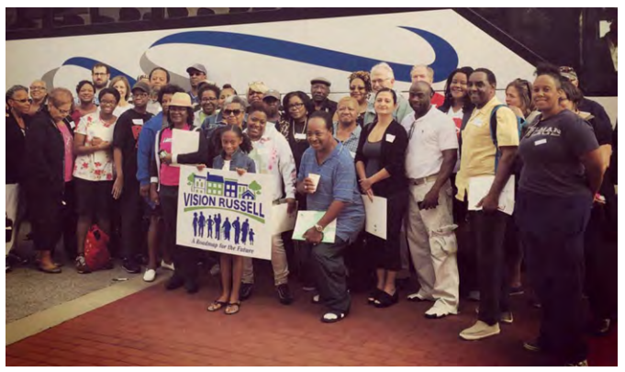
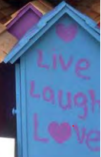
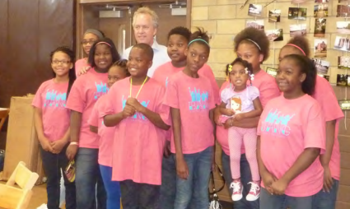
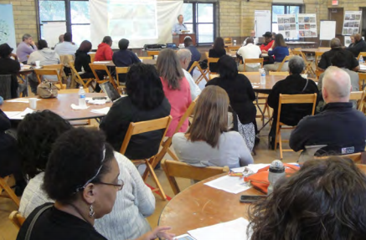
Community Engagement

Slide 7
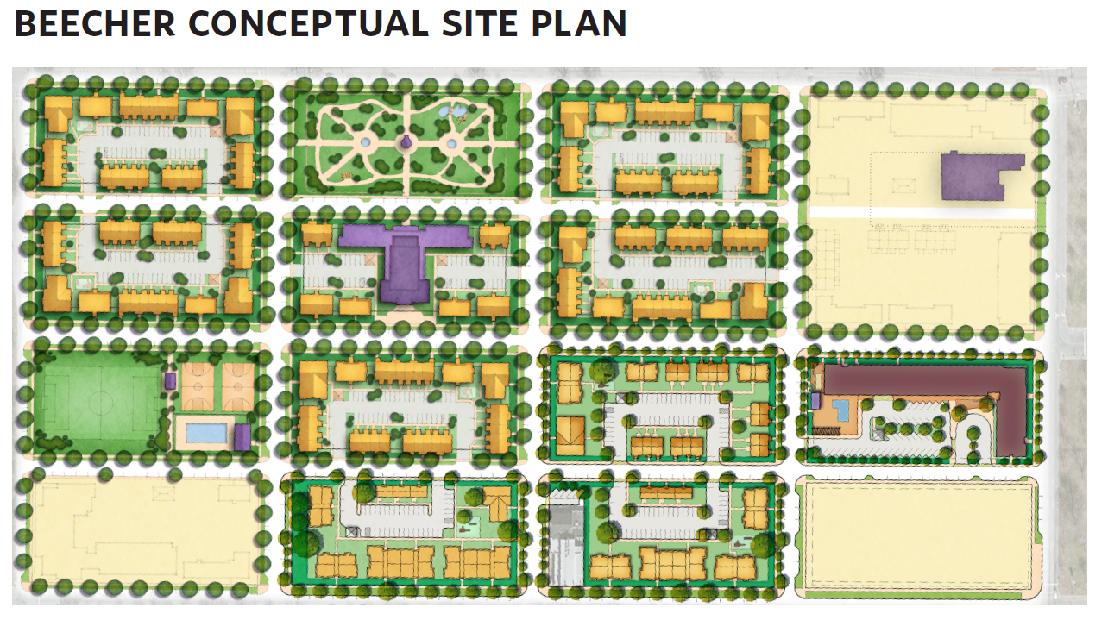
Phase I of Project
4 Stories
120 – Senior Units
Management Offices
Pool & Amenities
Notes:
Subject to change.

Slide 8
Project Milestones
(dates are subject to change)
Spring 2017: Phase 1 Relocation Began
Winter 2017: Phase 1 Relocation Completed
Spring 2018: Site Clearance Begins
Summer 2018: Phase 1 Housing Construction Begins
Fall 2018: Phase 1 Housing Completed
Spring 2020: Site Clearance Completed
Fall 2023: All Housing Construction Completed
9

Slide 9
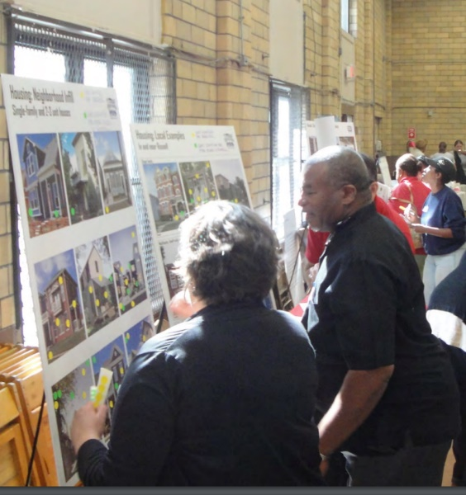
Project CONTACTS
RELOCATION BENEFITS - KATHY HEAD, (502) 569-3479
CHOICE NEIGHBORHOODS - KATHLEEN O’NEIL, (502) 569-3461
EVENT CALENDAR – CHLOE QUIROGA, (502) 569-3454
RUSSELL NEIGHBORHOOD – JEANA DUNLAP, (502) 574-4140
HISTORIC PRESERVATION – CYNTHIA ELMORE, (502) 574-2868
Write us at www.visionrussell.com

Slide 10
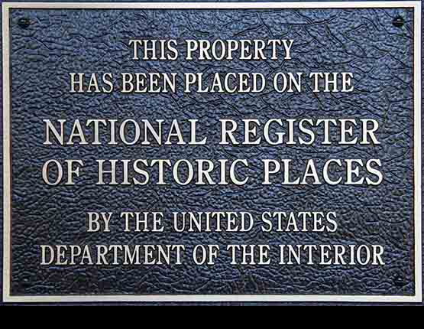
What is Section 106?
National Historic Preservation Act (1966):
Federal agencies are to take into account the effects of the undertaking on properties listed in, or eligible for listing in, the National Register of Historic Places (NRHP)
Afford the Advisory Council on Historic Preservation (ACHP) the opportunity to consult (www. achp.gov)
Notes:
The National Historic Preservation Act became a law in 1966. It was passed following a period of intense economic and commercial development in the United States. This development included the construction, by the federal government, of a large number of infrastructure projects that were critical to support economic growth and vital to preserving national security. This development had many consequences. Among them was the destruction of many historic buildings and archaeological sites as well as the demolition or degradation of numerous historic districts. In response to the devastation to these historic resources, the NHPA was enacted with the goal of balancing the need for development with the strong desire expressed by the public to preserve important historic places.
Section 106 of the NHPA provides a mechanism for the federal government to balance these goals. And it specifically provides communities and interested individuals with the rights to participate in the conversation about how to balance these needs. Section 106 of the NPHA reads:, let’s discuss these words and concepts more.

Slide 11
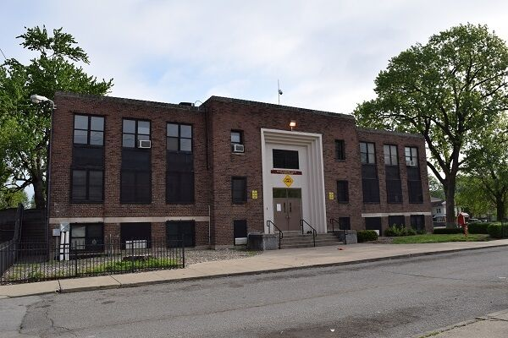
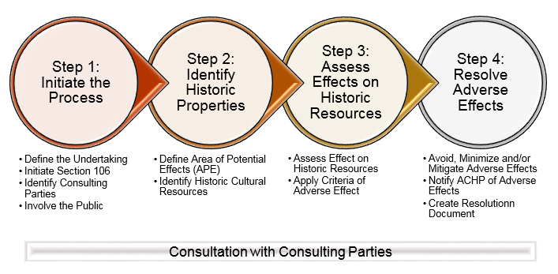
Section 106: Steps
Establish that there is an undertaking…
Step 1: Initiate consultation
Step 2: Identify historic properties
Step 3: Assess effects of the undertaking on historic properties
Step 4: Resolve any adverse effects
Notes:
The Section106 process has no predetermined outcomes. Every project is different, every outcome is distinct and specifically tailored to meet the needs to the community. The processes, is generally followed in a series of steps. Because Section 106 establishes a legal process, the steps required are legally defined. A decision tree identifying these steps is provided at the 106 Process table. Let’s look at each step

Slide 12
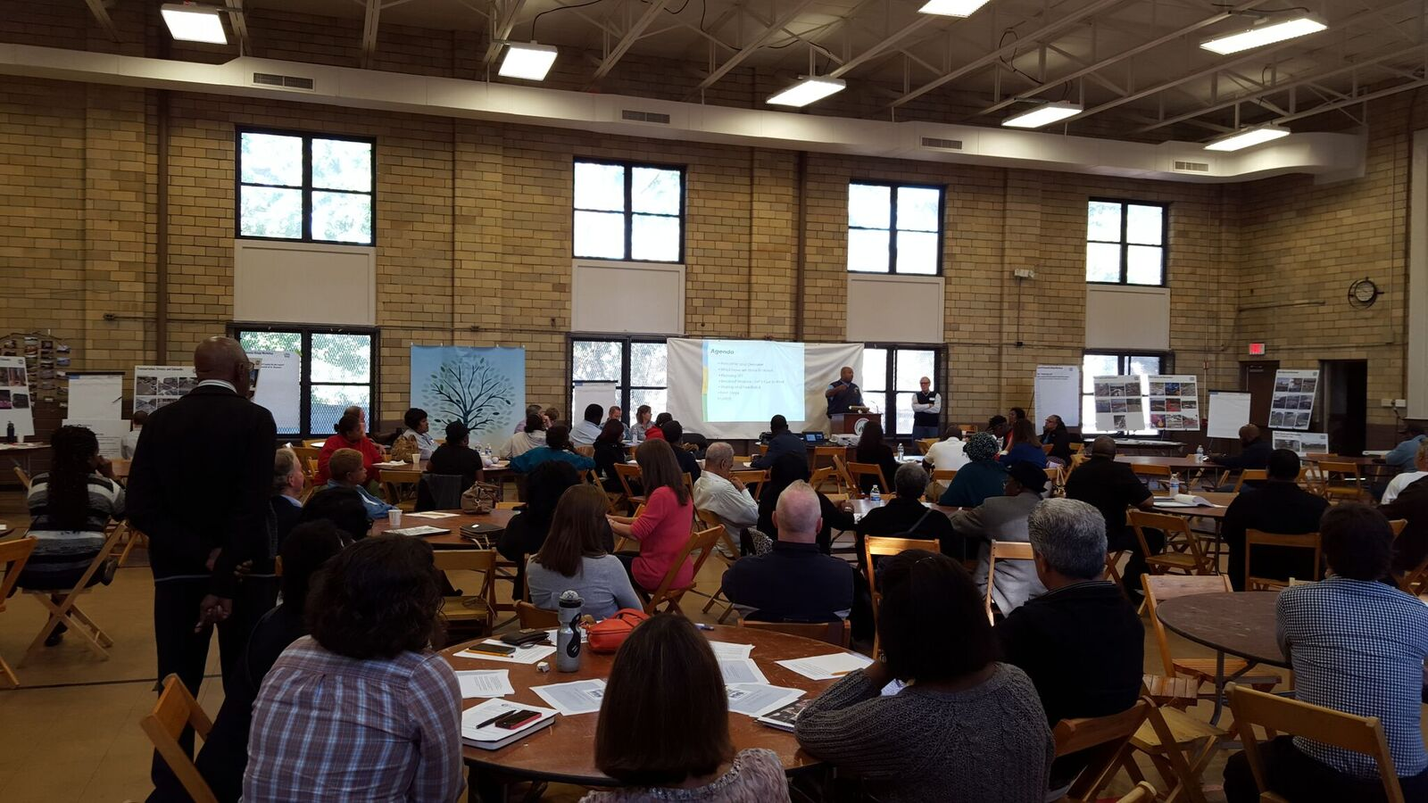
Step 1: Consultation
“The process of seeking, discussing and considering the view of other participants, and where feasible, seeking agreement with them regarding matters arising in the Section 106 process”.
[36 CRF 800.16(f)]
Notes:
The first step is consultation. That is what we are doing today. The law specifically defines consultation and the law requires the federal government to reach out to people and organization that have an interest in the project.
Consultation is built on the principal of exchanging ideas about the projects effect on eligible historic properties, not simply providing information. This meeting is geared to CPs providing their input and ideas regarding the project and its impacts on the historic resources. Communication is KEY. Jeana and Gretchen have discussed how Metro has engaged with the community to have a conversation about what the BT of the future will look like. The Section 106 process is a consultation to help Metro understand those historic elements of the existing BT and the surrounding neighborhood that are important to you as a community. And to help Metro understand ways to celebrate and commemorate those historic values in the BT of the future.

Slide 13
Who are the Consulting Parties?
Advisory Council on Historic Preservation (ACHP)-By right
Provide historic preservation leadership with the federal government
Ensure that Section 106 process is met
State Historic Preservation Officer (SHPO)-By right
Advise and assist the federal agency
Ensure historic properties are taken into consideration
Local Governments-By right
Indian Tribes-By right
Identify concerns and advise on the identification historic properties of significance to the tribe and participate in the resolution of adverse effects
Government to government relationship
Other individuals or organizations with a demonstrated interest in the project due to the nature of their legal or economic relation to the undertaking or affected properties or their concern with the undertakings effects on historic properties -By invitation, subject to approval by federal agency
Historical societies
Preservation societies
Landowners
Notes:
Who does Metro consult with? Many of your were specifically invited here as CP’s. Some Consulting Parties are designated as CP’s by right. This means they automatically are included as CPs and have certain rights and responsibilities in the process. For the current process, CPs by right are the ACHP, SHPO, Tribes that choose to Participate, and LMHA. Other consulting parties are groups and organizations with specific and definable interests in the process or the project.
As an attendee at this meeting, you were invited to participate in the process. Please let us know at the 106 table if there are other parties you think we should include.

Slide 14
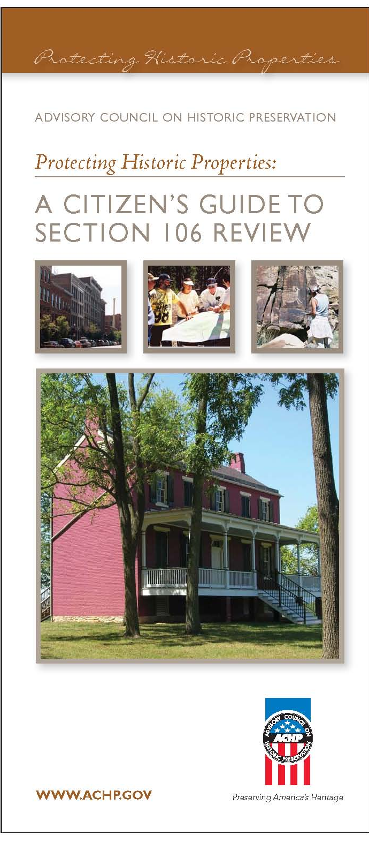
Role of Consulting Parties
Assist in identifying other consulting parties
Help identify historic resources
Tell the Agency why these Places are Important to you
Provide data
Review documentation and reports (within deadlines)
Voice input and propose mitigation options
Participate/comment at any step in the process
[36 CFR 800.2(c), 800.3(f) and 800.4(a)(3-4)]
Notes:
The most important job of a consulting party is to tell Metro why the historic properties here are important to you. You do this by providing comments on documents and by participating in the process. Many of you were invited here today as potential CPs. CP’s are organizations and individuals with a demonstrated interest, legal or economic, in the historic properties impacted by the project.

Slide 15
Step 2: Identify Historic Properties
Establish an Area of Potential Effects (APE): “Area of potential effects means the geographic area or areas within which an undertaking may directly or indirectly cause alteration in the character or use of historic properties, if any such properties exist”.
[36 CFR 800.16(d)]
Historic property is defined as “any prehistoric or historic district, site, building, structure or object included in, or eligible for inclusion in, the National Register of Historic Places”. [36 CFR 800.16(l)]
Consulting parties help to identify these properties
Notes:
In order to identify historic properties that might be impacted by the project, we need to define the area that might be effected by the project, this is called the Area of Potential effect. Once the APE is defined, we can look within the APE for historic properties. This is one of the most confusing terms in the process, it refers to both historic and prehistoric resources.

Slide 16
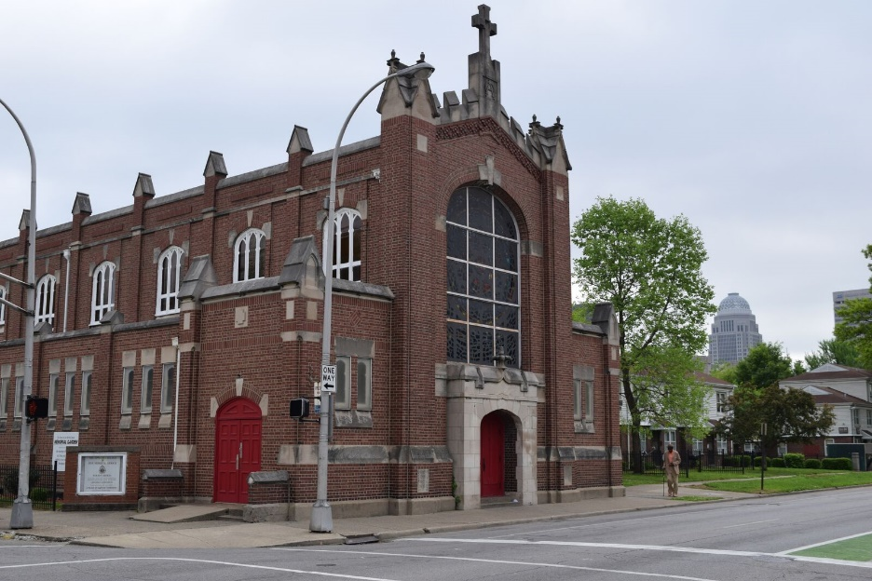
Step 2: Evaluating Historic Properties
Assess Integrity:
Location
Design
Setting
Materials
Workmanship
Feeling
Association
Apply National Register Criteria:
Association with events that have made a contribution to the broad patterns of history
Association with the lives of significant persons
Embodiment of the distinctive characteristics of a type, period, or method of construction, or that represent the work of a master, or that possess high artistic values, or that represent a significant or distinguishable entity whose components may lack individual distinction
Have yielded, or may be likely to yield, important data (i.e.: archaeology)
Consulting parties provide comments on these evaluations
Notes:
Once properties are identified, they are evaluated to see if they are eligible for the NRHP. They will only be considered historic properties for the purpose of the 106 process if they are eligible for the NRHP. This does not mean that they are not important places, only that they do not meet the technical definition of a historic place. As rules of thumb, historic properties must have integrity, they must look enough like they did when originally built to convey their significance, AND they must meet at least one of the criterial of eligibility. They are usually more than 50 years old. The criteria include:
So, we have defined our area of effect, we have identified our historic properties, now we move to step 3.

Slide 17
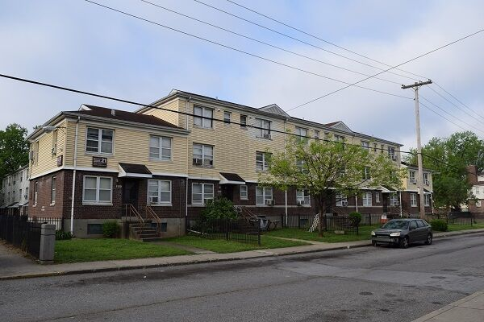
Step 3: Assess effects
A finding of historic properties affected will be:
No Adverse Effect or
Adverse Effect
[36 CFR 800.5 (d) (1) and (2)]
Consulting parties provide comments on these determinations
“Effect means alteration to the characteristics of a historic property qualifying it for inclusion in or eligibility for the National Register.”
[36 CFR 800.16(i)]
Effects of an undertaking will be:
No Historic Properties Affected or
Historic Properties Affected
[36 CFR 800.4 (d) (1) and (2)]
Notes:
Once we have identified historic properties, we need to decide if the project will actually have an effect on the properties. Sometimes you identify historic properties, but you determine that the project won’t effect the qualities that make those properties eligible for the National Register. Other times you identify historic properties, and the project will effect those qualities. In this case, your project will have an what is know as an adverse effect. What are some examples?

Slide 18
Step 4: Adverse effects
Adverse effect occurs when the undertaking alters the characteristics of a historic property “in a manner that would diminish the integrity of the property’s location, design, setting, materials, workmanship, feeling or association”.
[36 CFR 800.5 (a) (1)]
Examples:
Destruction of property
Alteration
Removal from original location
Introduce visual, atmospheric or audible elements
Notes:
The BT project will have an adverse effect. Adverse effects can be either direct or indirect. These effects result directly in the loss of the properties historic qualities and, as a result, they diminish the communities ability to enjoy the historic character and qualities of the resource. If these qualities are lost, the federal agency is required to resolve or mitigate the adverse effect. Some examples of adverse effects are:

Slide 19
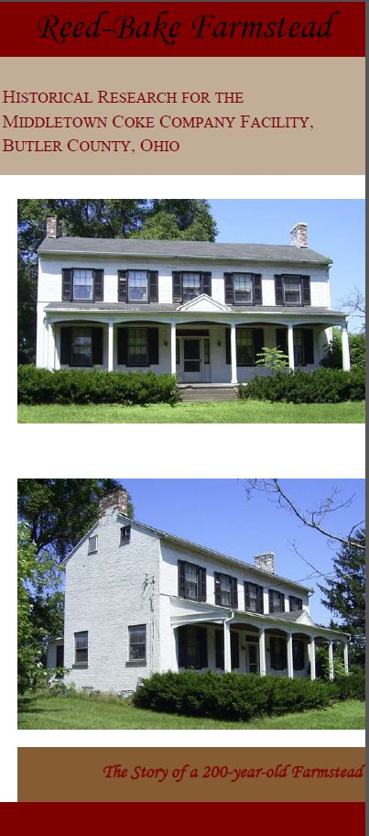
Step 4: Resolve Adverse Effects
Identify measures to avoid, minimize or mitigate the adverse effects
Consulting parties provide suggestions for mitigation or comment on measures proposed
Consulting parties do not dictate the outcome
Create Resolution Document such as a Memorandum of Agreement (MOA) or a Programmatic Agreement (PA) that formalizes the results and agreed mitigation
Mitigation Example – brochure created for a historic farmstead
Notes:
Resolution of the effect is the federal governments way of making up for the loss of value that comes with the destruction of historic resources. While the community loses a resource, they will gain something else.
The resolution of these effects is written down in an agreement document that is signed by the agency and some of the consulting parties. We have a table dedicated to discussing options for resolving the effects of the project on historic resources in BT.

Slide 20
Status of Section 106 for Beecher Terrace Project
Project has been determined to be an Undertaking by the Louisville Metro Government, acting as the Responsible Entity
Step 1: Initiate the Project-This meeting initiates the formal Section 106 Consultation for the Project.
Step 2: Identify and Evaluate historic properties-Archaeological and Architectural Surveys have been completed.
Step 3: Assess effects of the undertaking
on historic properties-Project will have
an Adverse Effect on Historic properties
Step 4: Resolve any adverse effects-
Will develop a PA to resolve effects
Notes:
These are all the steps! Where are we in this process for the BT project?
Step 1- Is starting formally for Section 106 now, but as discussed above, the project overall has included significant interaction with the community. Parties invited to consult include KY SHPO, ACHP, Native American Tribes, Local preservation groups, neighborhood groups, BT residents
Step 2-Complete-Reports are on file or will be soon. A/H report is available for comment. All correspondence related to the record is also available. Archaeology report will be posted once we have received SHPO comments.
Step 3-LMG has already determined and SHPO has already concurred that the project will have an adverse effect on historic properties.
Step 4- Metro knows that there will be many effects that they cannot define yet. Thus, they are considering a Programmatic Agreement to help resolve the effects now and into the future.

Slide 21
Step 2: Identify Historic Properties
One New Historic District-Beecher Terrace Historic District
Beecher Terrace Complex
Baxter Community Center
Baxter Square Park
Two Archaeological Sites
Baxter Square Park
Beecher Terrace
Three Historic Buildings
Fire Department Headquarters
St. Peters Church
Merciful Savior Church
Notes:
The archaeologists and architectural historians associated with the projects were at tables in the room and were able to provide more details about each property impacted by the project.

Slide 22
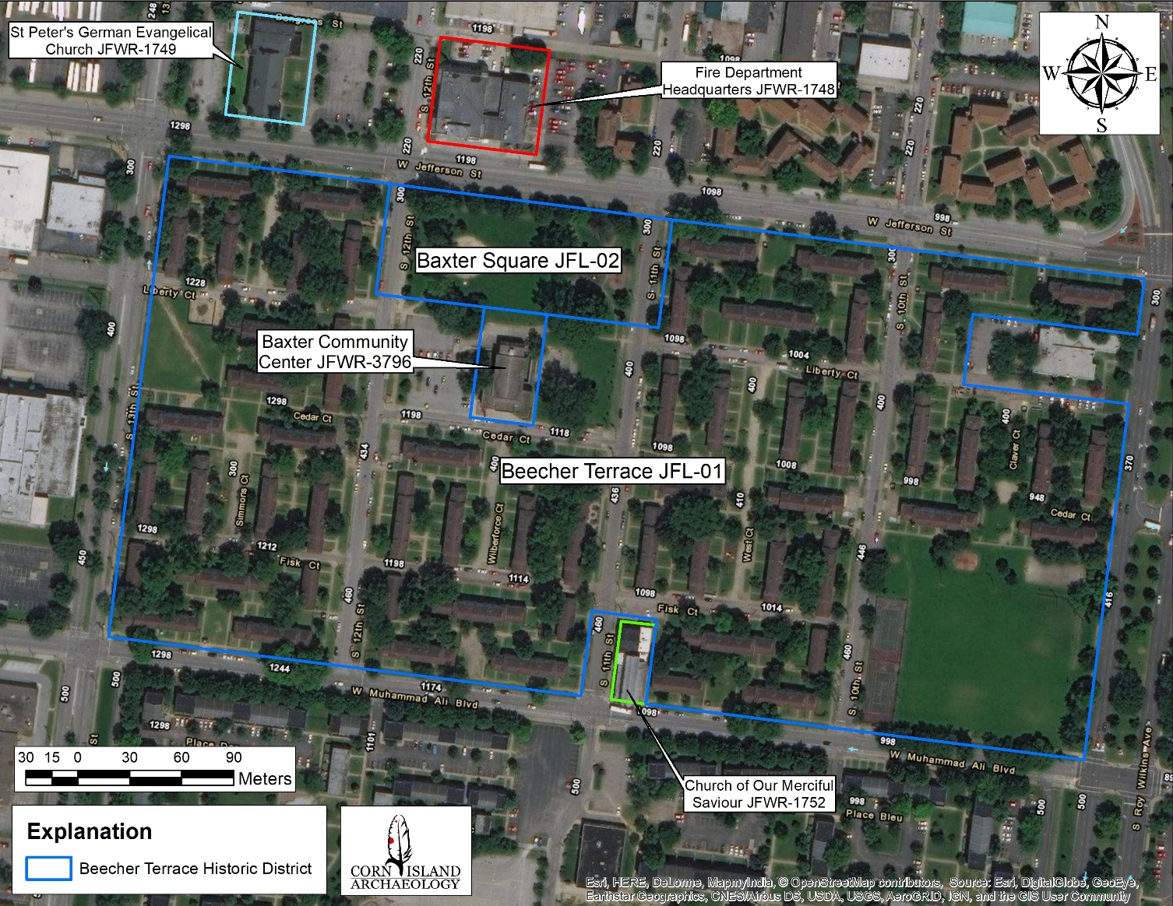
Notes:
Fire Department Headquarters-JFWR-11748 at the top of the map
St. Peters Church-JFWR-1749-NW corner
Merciful Savior Church-JFWR-1752-At the bottom of the map

Slide 23
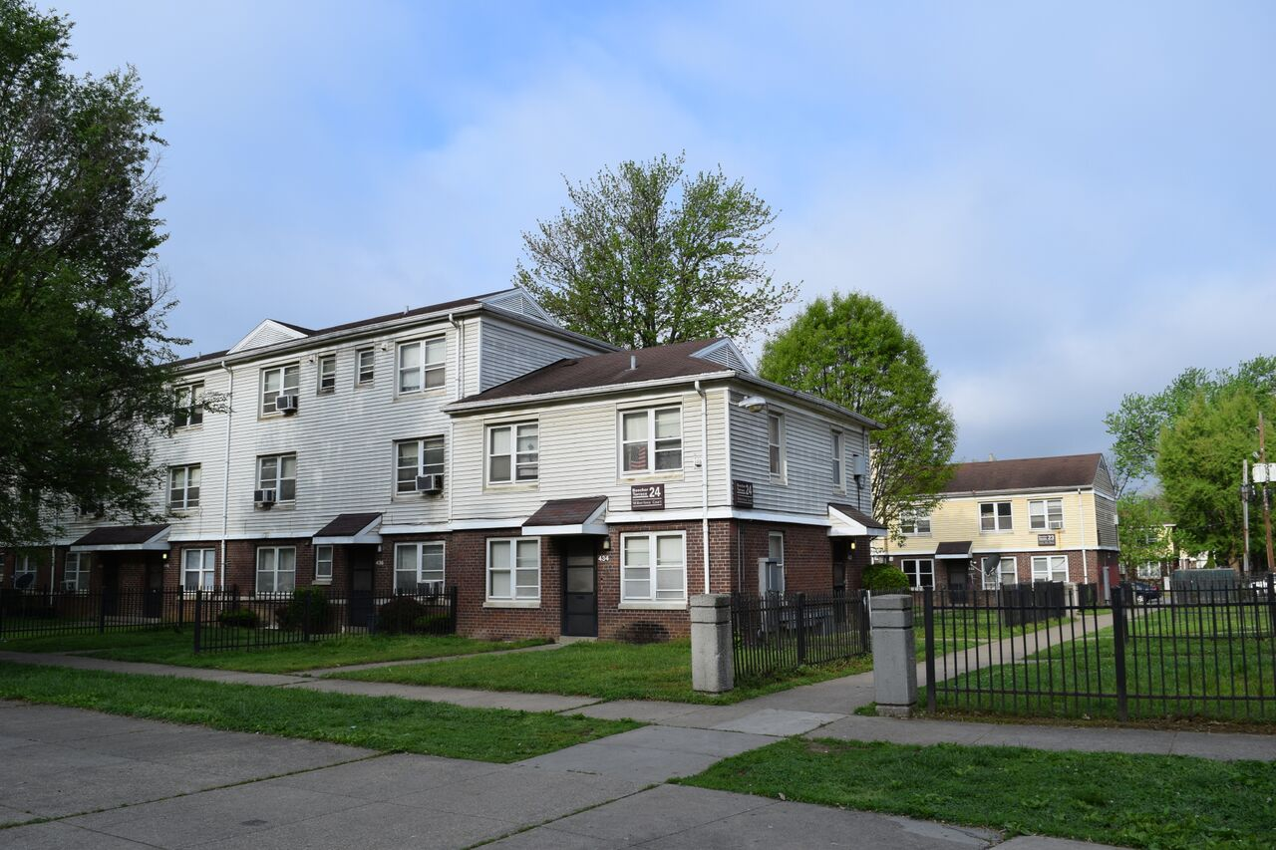
Beecher Terrace Historic District
Notes:
Includes all of BT, Baxter Community Center, and Baxter Park. Important because of the association with the BT neighborhood and community. Community center has a long history as a gathering place in the neighborhood. What are the elements of this historic place that are important to the community historically and why? What are the elements that should be celebrated and commemorated as we move forward with the project?

Slide 24
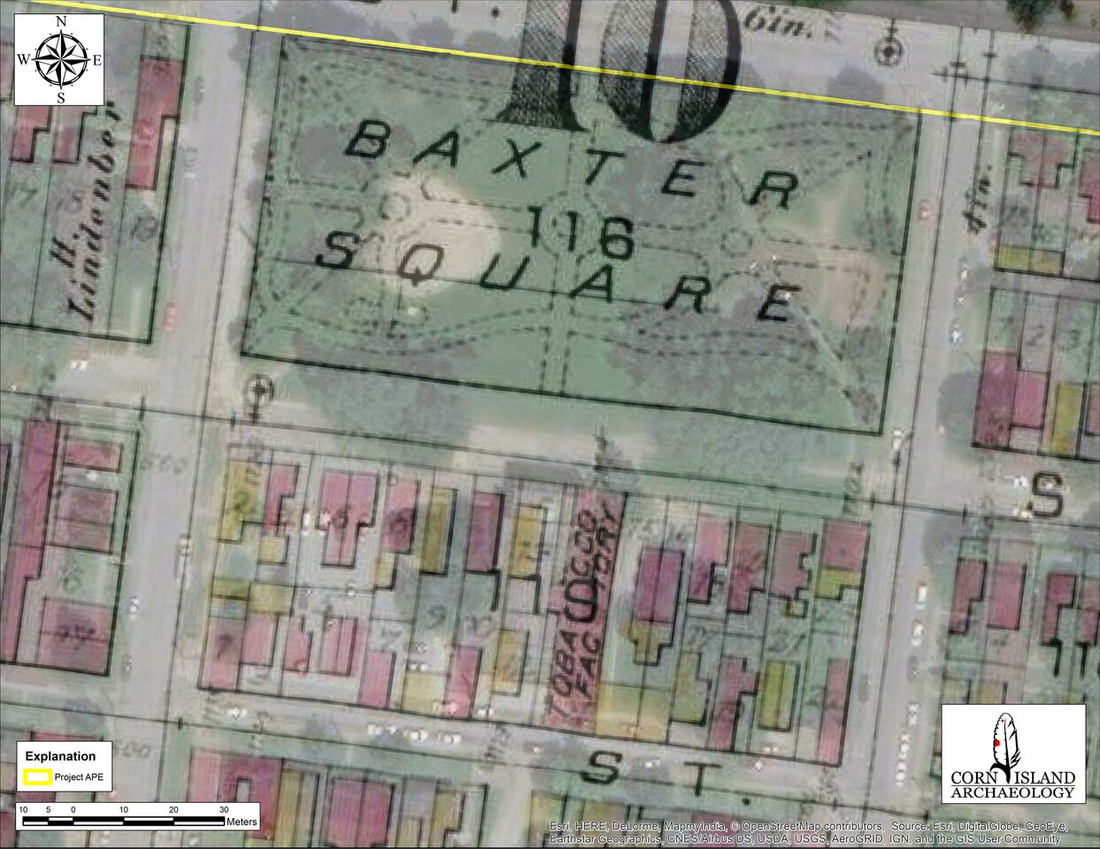
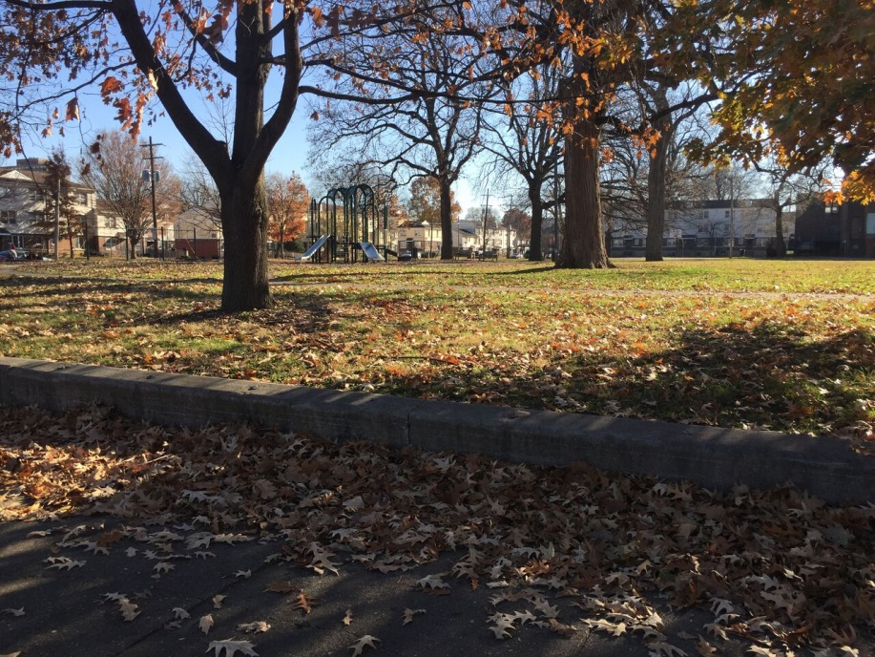
Baxter Square Park
Notes:
Baxter Square Park is both part of the new Historic District and it is an archaeological site. It is part of the district due to its long association with the BT neighborhood. The park was designated as African Americans only from 1924 into the 1960’s and has long been associated with the Beecher Terrace neighborhood.
The park was also an important place prior to the construction of the BT complex. Baxter Square is Louisville’s first public park, it was established in 1880. The map is from the Beers and Lanagan’s 1884 atlas of Louisville. The park was destroyed by a tornado in 1890 and incorporated into a 1891 plan proposed by Frederick Law Olmsted for Louisville Parks and Parkways. The park plan was not completed until 1901. The park is named in honor of John Baxter, who was mayor wen the park was inaugurated.
In addition to its importance as a gathering place and as a park of the Olmsted designed parks system, Baxter Square sits on top of the first public burial ground In Louisville. Historic documents and maps tell us that the first cemetery was on Jefferson St. between 11th and 12th streets and was used as early as 1786. The cemetery was closed in 1820 and a second cemetery was set up 3 blocks west called the Western Cementery.

Slide 25
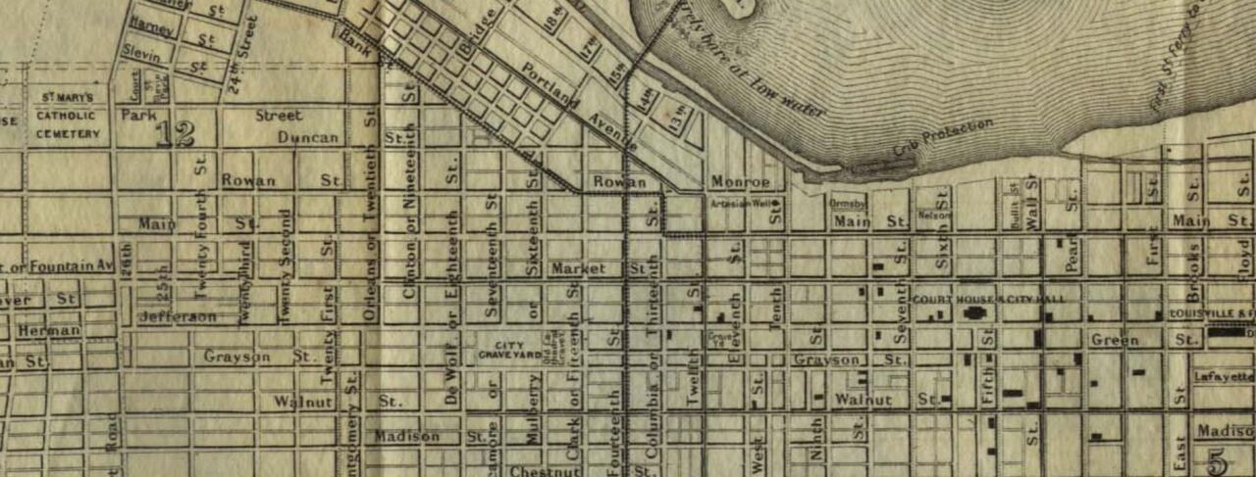
Notes:
The exact location of the cemetery is described in historic documents dating back as far as 1791. The records indicate that the cemetery is located directly below what is now designated as Baxter Square. It is likely that some of the earliest settlers in Louisville were buried in this cemetery. This map, made in 1873 but surveyed in 1855, show the cemetery as a Grave Yd. All of the historic documents indicate that the cemetery was confined to the area now occupied by Baxter Square Park.
Archaeological trenching in the park confirmed that intact graves were still present below the surface.

Slide 26
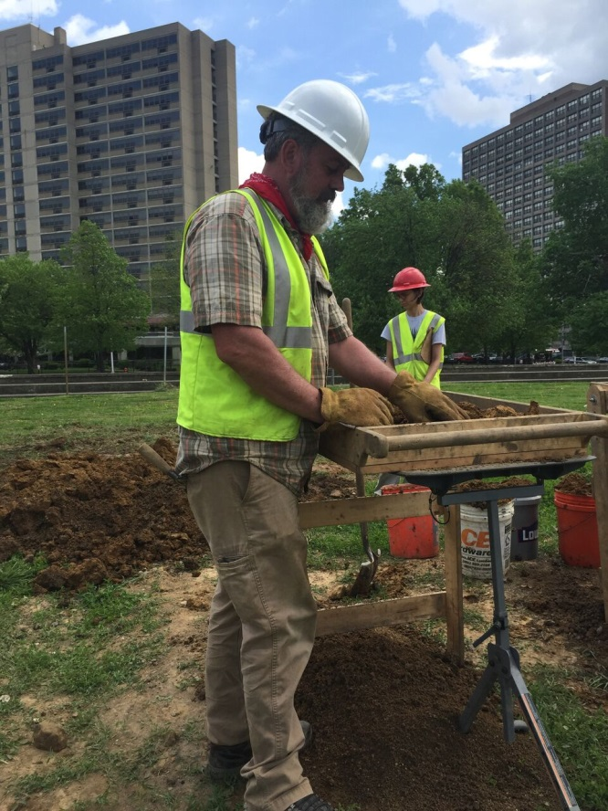
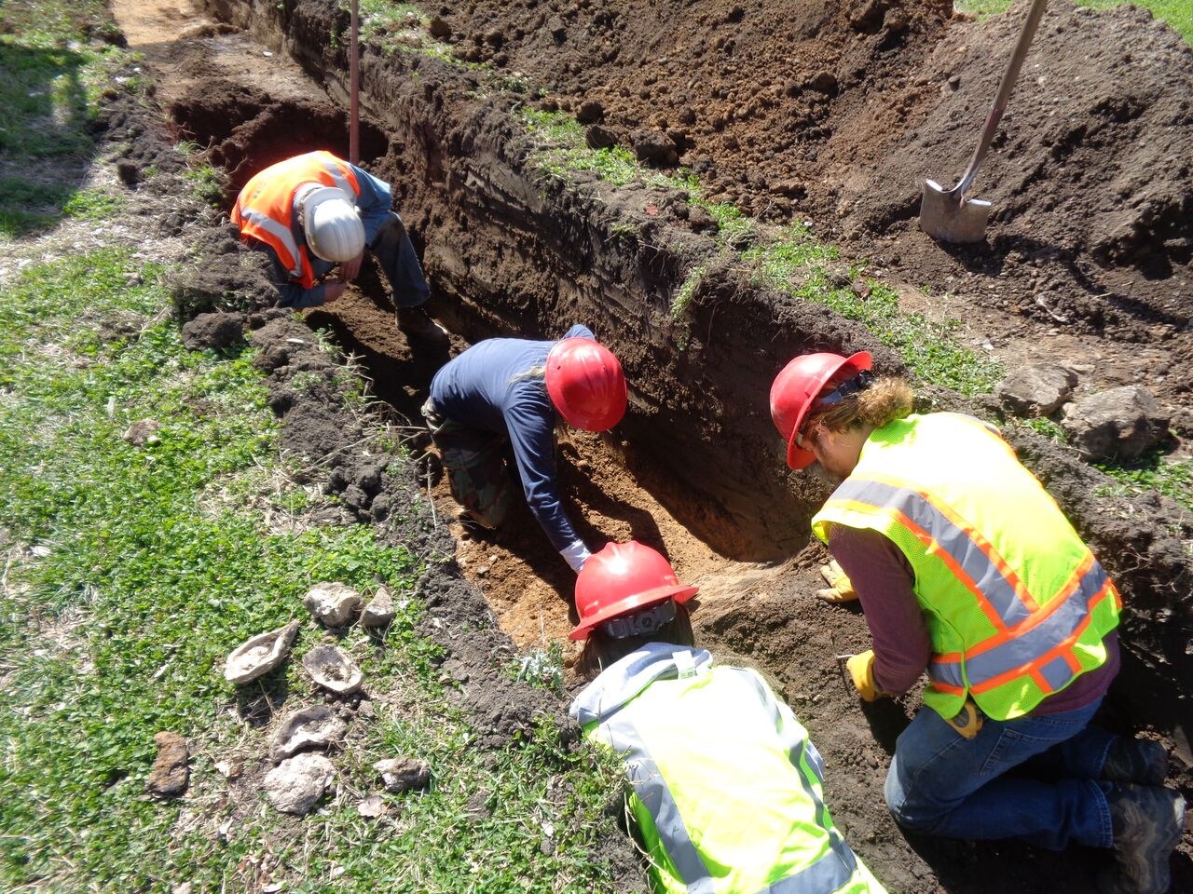
Beecher Terrace Archaeological Site
Notes:
The site encompasses all of the BT complex and includes a wide variety of historic neighborhoods that were there before the BT complex was built. Maps from the 1880s and 1890s show exactly where houses in the neighborhood were located, archaeological investigations showed that there are many intact remains of these neighborhoods still present. These neighborhood were traditionally African American, but records indicate many residents listed as “mullato” and a few Germans. Additional research is underway to understand each small neighborhood that existed below the current BT complex.

Slide 27
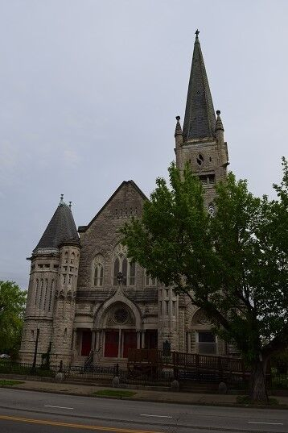
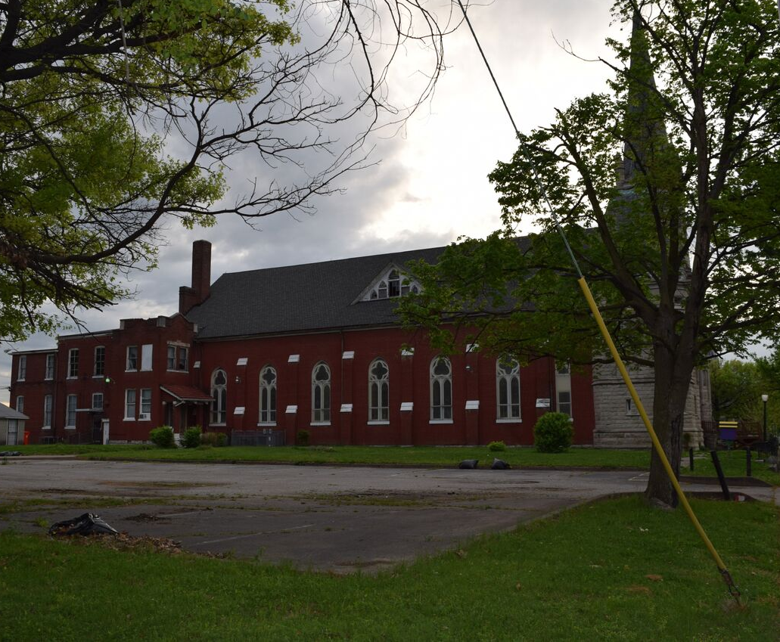
St. Peter’s United Church of Christ
Notes:
Originally St. Peter’s German Evangelical Church, Gothic Revival, constructed `1894-1895. Limestone, one of the most detailed buildings in Louisville by architectural firm of Clarke and Loomis. Congregation originated in 1847 to serve German population in west Louisville. Listed in 1980 under criterion A and C. Significant for the German community under A. Can also argue it served BT and Russell after WW II. Survived urban renewal.
Temporary indirect adverse effect on the viewshed. Important community gathering place with a multi-cultural, multi-generational congregation.

Slide 28
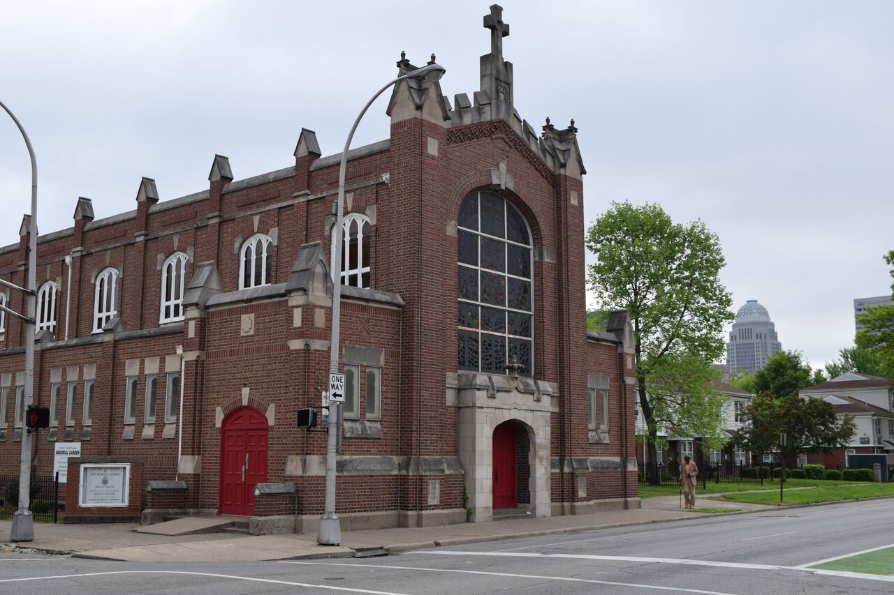
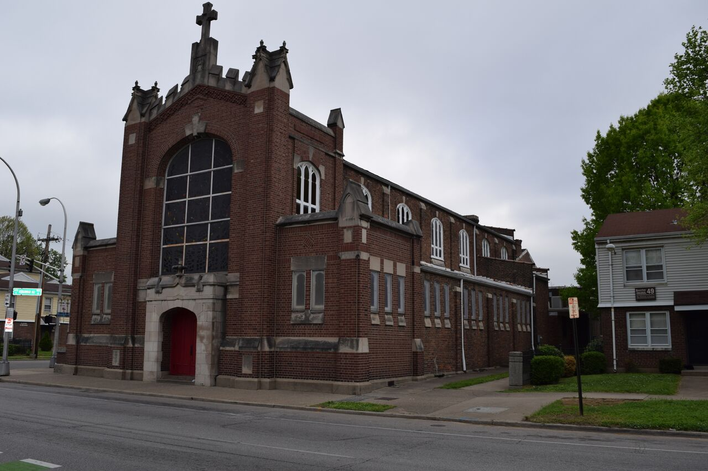
Church of Our Merciful Savior
Notes:
Constructed ca. 1912, Gothic Revival style. Eligible for the architecture, also played an important role in Louisville’s African-American community. Congregation originated with St. Mark’s African Church, a mission church dating to 1865. Adopted new name in 1873. Sponsored first African-American boy scout troop in Louisville and is on of Louisville’s oldest African American congregations.

Slide 29
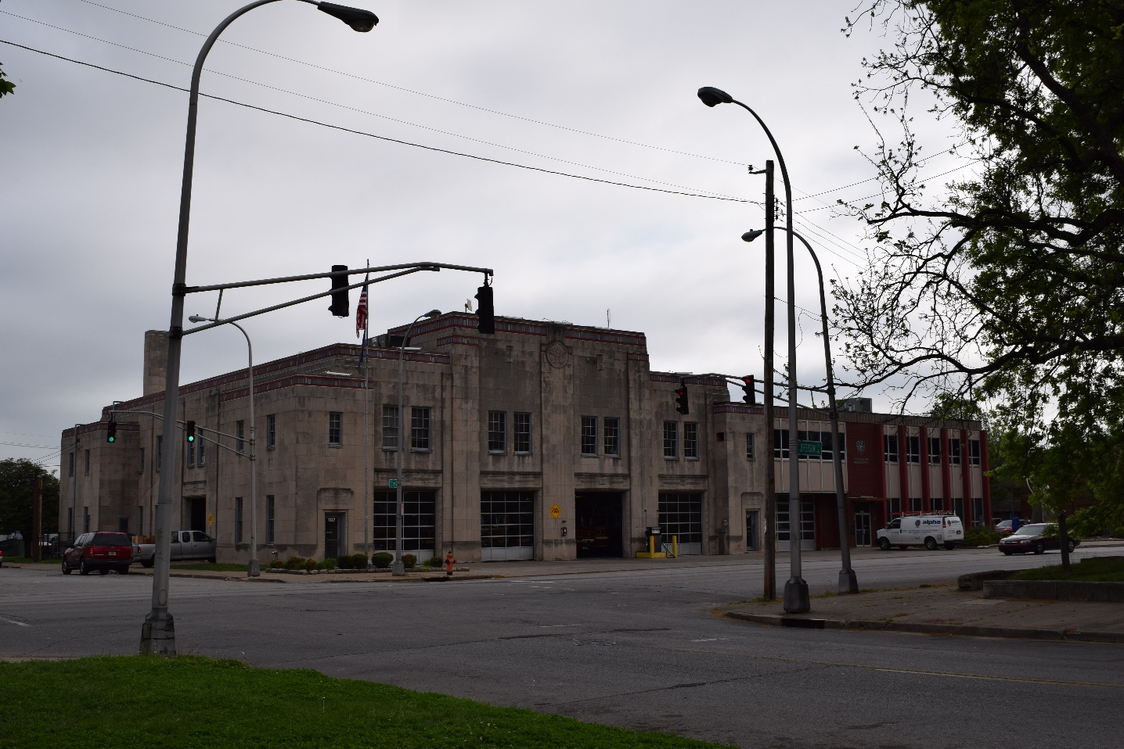
Fire Department Headquarters
Notes:
Two story limestone building. Built 1936-1937 on a design by Brinton Davis. Art Deco style with 6 bays. Cornice with narrow band of brass shields . Listed on the NRHP in 1980 under criterion C due to its Art Deco style and as part of the Works Project Administration. Also unique color of cornice.

Slide 30
Next Steps
Continue Consultation- Maintain consultation channels across the project, identify additional Consulting Parties
Evaluate Resources-Obtain input from Consulting Parties on identification and evaluation efforts conducted to date
Assess Effects on Historic Properties-Get input from Consulting Parties on the assessment of Effect
Resolve Adverse Effects-Draft an agreement document to begin to resolve adverse effects

Slide 31
Section 106 Timeline
Winter 2017: Consulting party meetings #1 and #2 to discuss the APE, eligible properties and Assessment of Effect.
Spring 2018: Draft and circulate Programmatic Agreement for review and comment.
Execute the Programmatic Agreement and complete the Section 106 Review Process.
Spring 2018 Until…..decisions are completed:
Implement the Programmatic Agreement by reporting out and meeting with Consulting Parties.

Slide 32
Project CONTACTS
RELOCATION BENEFITS - KATHY HEAD, (502) 569-3479
CHOICE NEIGHBORHOODS - KATHLEEN O’NEIL, (502) 569-3461
EVENT CALENDAR – CHLOE QUIROGA, (502) 569-3454
RUSSELL NEIGHBORHOOD – JEANA DUNLAP, (502) 574-4140
HISTORIC PRESERVATION – CYNTHIA ELMORE, (502) 574-2868
Write us at www.visionrussell.com

