Slide 1
Section 106 Consulting Parties Meeting
January 30, 2018
Tim Barry, Louisville Metro Housing Authority
Gretchen Milliken, Louisville Metro Government
Jeana Dunlap, Louisville Metro Government
Cynthia Elmore, Louisville Metro Government
Cinder miller, gray & Pape, cultural resources

Slide 2
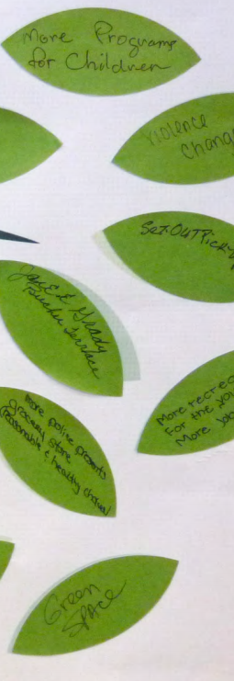
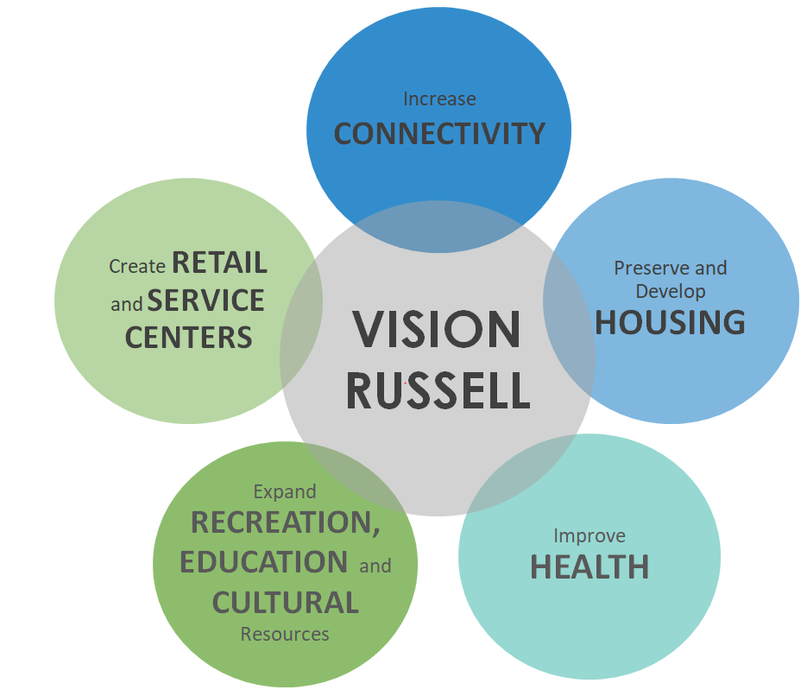
Project Overview
People
Housing
Education
Neighborhood

Slide 3
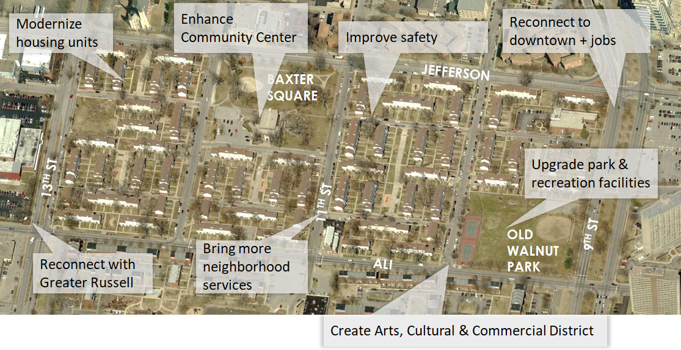
Need for the Project

Slide 4
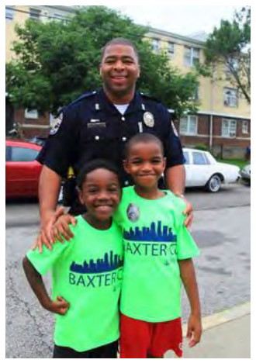
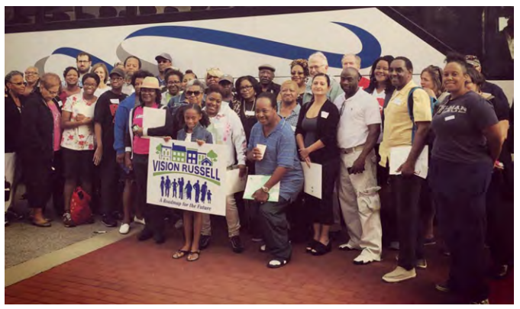
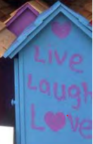
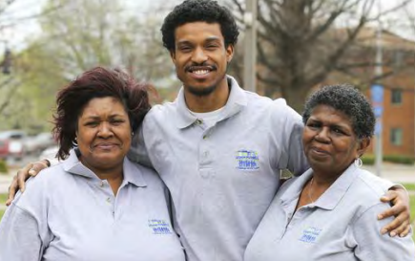
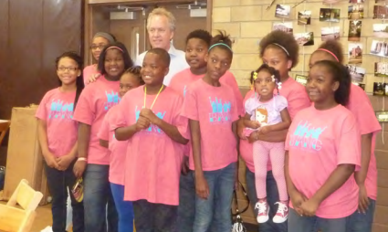
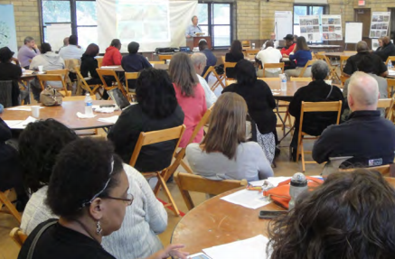
Community Engagement

Slide 5
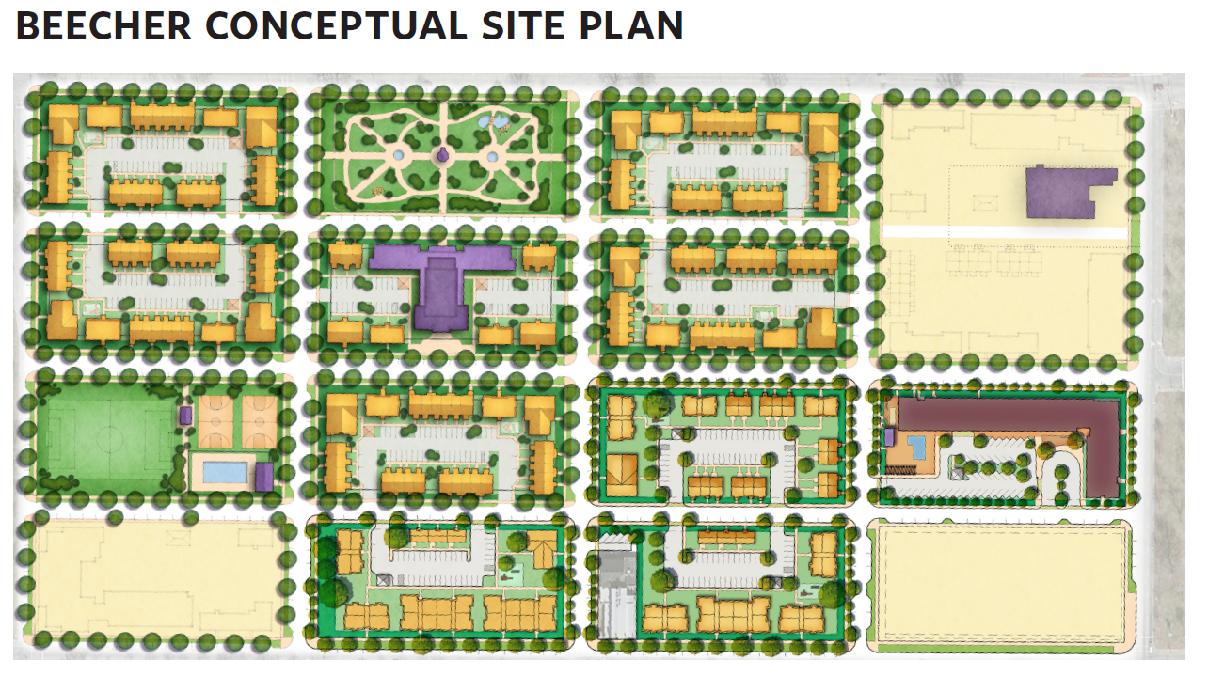
Phase I of Project
4 Stories
120 – Senior Units
Management Offices
Pool & Amenities

Slide 6
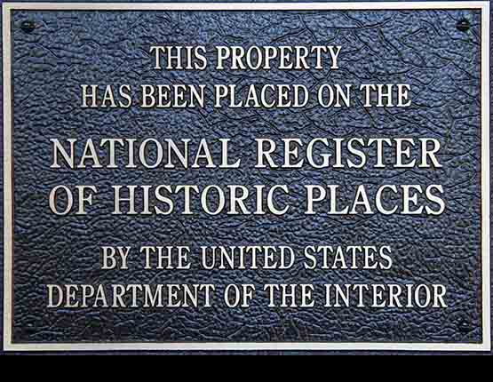
What is Section 106?
National Historic Preservation Act (1966):
Federal agencies are to take into account the effects of the undertaking on properties listed in, or eligible for listing in, the National Register of Historic Places (NRHP)
Afford the Advisory Council on Historic Preservation (ACHP) the opportunity to consult (www. achp.gov)
Notes:
Last meeting we reviewed the concepts of Section 106 of the National Historic Preservation Act. We noted that the NHPA was enacted with the goal of balancing the need for economic and commercial development with the strong desire expressed by the public to preserve important historic places.
Section 106 of the NHPA provides a mechanism for the federal government to balance these goals. And it specifically provides communities and interested parties with the right to participate in the conversation about how to balance these needs.

Slide 7
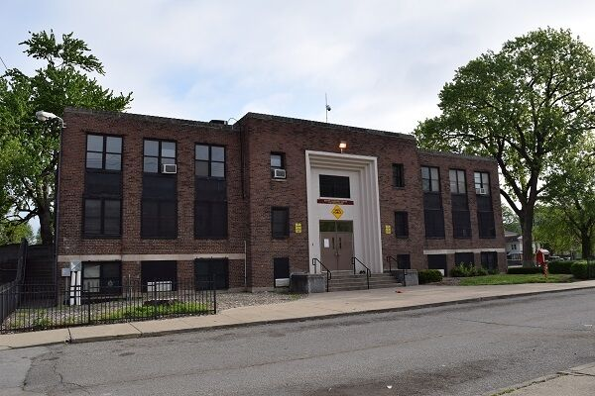
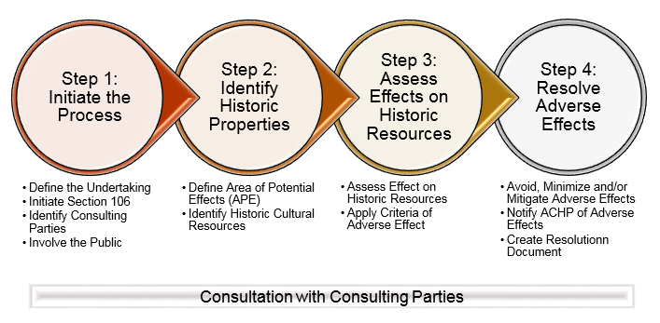
Section 106: Steps
Establish that there is an undertaking…
Step 1: Initiate consultation
Step 2: Identify historic properties
Step 3: Assess effects of the undertaking on historic properties
Step 4: Resolve any adverse effects
Notes:
The Section106 process has no predetermined outcomes. Every project is different, every outcome is distinct and specifically tailored to meet the needs to the community. The processes, is generally followed in a series of steps. Because Section 106 establishes a legal process, the steps required are legally defined. A decision tree identifying these steps is provided on the board in the corner.
The Undertaking is everything that is included in the whole Beecher Terrace Development Project. The CNI grant for the project covers all of the different Phases, from the initial Phase I wellness center to the final stages of the rebuilding of the BT neighborhood. Not all of these phases are well defined yet. The Lead Federal agency for the project is HUD, HUD has delegated its authority for complying with Section 106 to Louisville Jefferson County Metro Government.
Consultation is an ongoing process throughout the project. Let’s review where we are with the consultation process.

Slide 8
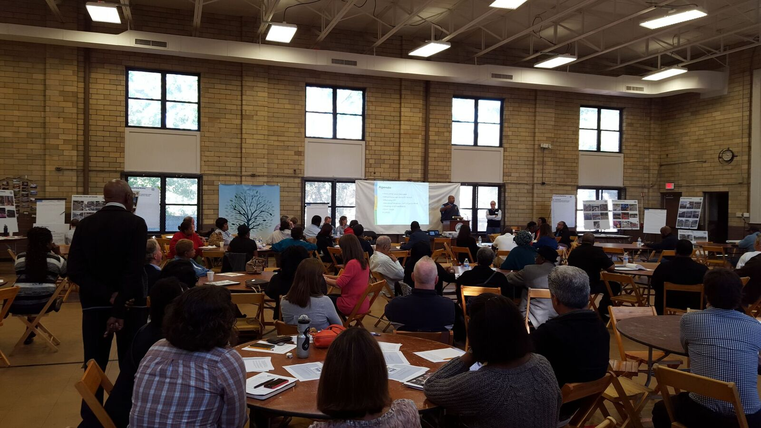
Step 1: Consultation
“The process of seeking, discussing and considering the view of other participants, and where feasible, seeking agreement with them regarding matters arising in the Section 106 process”.
[36 CRF 800.16(f)]
Notes:
As we noted, the implementing law for Section 106 defines consultation. This meeting is part of this process.

Slide 9
Who are the Consulting Parties?
By Invitation
Kentucky Organization of Professional Archaeologists
Kentucky Office of State Archaeology
Louisville Council Districts 4 & 5
Urban Strategies
Louisville Western Library African American Archives
Louisville Story Program
Black Media Collaborative
University of Louisville
St. Peters United Church of Christ
Six members of the public
Commonwealth Preservation Trades Program
Neighborhood Planning and Preservation, Inc.,
Concerned Pastors of Russell
Louisville Central Community Center
The Beech
Olmsted Parks Conservancy
Wayside Christian Mission
Westside Institute of Technology
By Right-
Advisory Council on Historic Preservation (ACHP)
State Historic Preservation Officer (SHPO)-Kentucky Heritage Council
Louisville Metro Housing
Native American Tribes-seven tribes contacted, and three have chosen to participate in the process
Notes:
Who does Metro consult with? Many of your were specifically invited here as CP’s. Some Consulting Parties are designated as CP’s by right. This means they automatically are included as CPs and have certain rights and responsibilities in the process. For the current process, CPs by right are the ACHP, SHPO, Tribes that choose to Participate, and LMHA. Other consulting parties are groups and organizations with specific and definable interests in the process or the project. Metro invited 37 different organization and people to participate in the process.

Slide 10
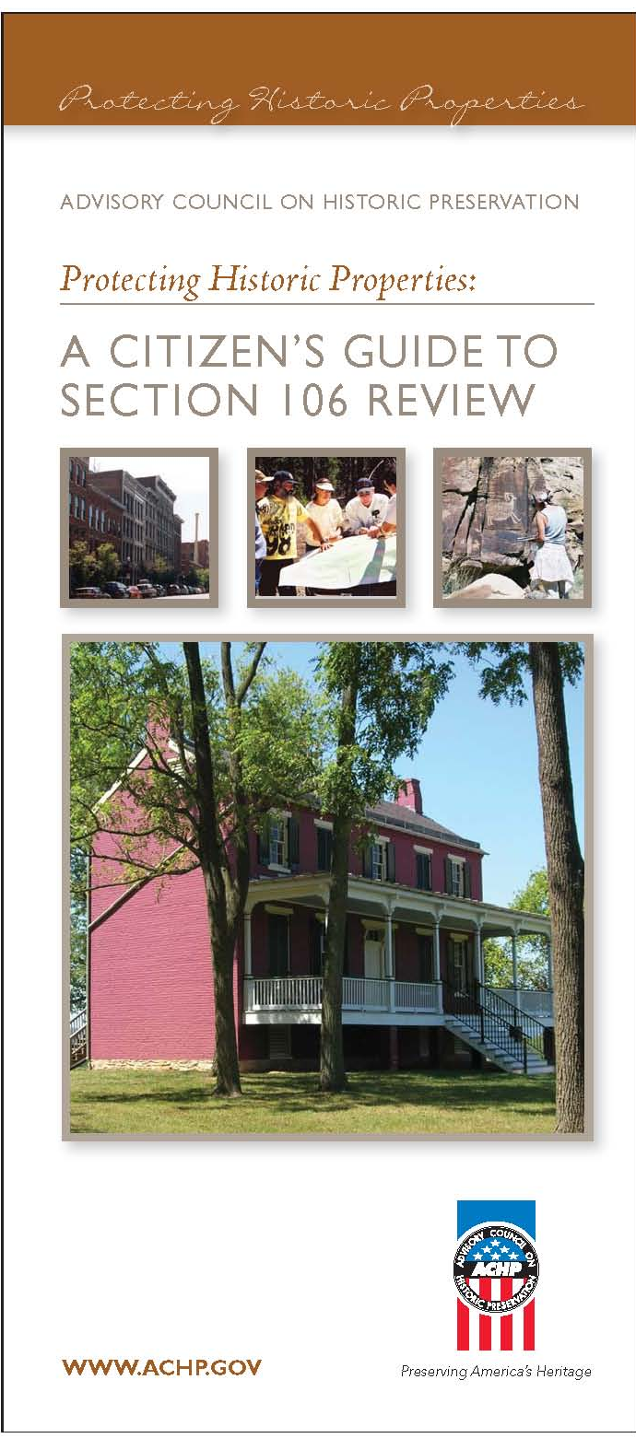
Role of Consulting Parties
Assist in identifying other consulting parties
Help identify historic resources
Tell Metro why these Places are Important to you
Provide data
Review documentation and reports (within deadlines)
Voice input and propose mitigation options
Participate/comment at any step in the process
[36 CFR 800.2(c), 800.3(f) and 800.4(a)(3-4)]
Notes:
The most important job of a consulting party is to tell Metro why the historic properties here are important to you and how you would like to see these places commemorated, preserved, and celebrated as Metro moves forward with the project. You do this by providing comments on documents and by participating in the process. As CP’s, you, or your organization, has demonstrated a legal, economic, or preservation related interest in the project. At this meeting we will focus on mitigating resources that we know will be impacted by the project.

Slide 11
Status of Section 106 for Beecher Terrace Project
Project has been determined to be an Undertaking by the Louisville Metro Government, acting as the Responsible Entity
Step 1: Initiate the Project-Process initiated in December. Ongoing.
Step 2: Identify and Evaluate historic properties-Archaeological and Architectural Surveys have been completed.
Step 3: Assess effects of the
Undertaking on historic properties-
Project will have an Adverse Effect
Step 4: Resolve any adverse
effects-Developing a PA to resolve
effects
Notes:
These are all the steps! Where are we in this process for the BT project?
Steps 1 and 2- Have identified additional consulting parties. All identification reports submitted. Comment Period on Above Ground resource report is closed. Archaeology report is under review by KHC. Will circulate to other parties soon.
Step 3-LMG has already determined and SHPO has already concurred that the project will have an adverse effect on historic properties. BT Historic District will be adversely effected. Currently working to identify any indirect effects to the project and to identify effects of later stages of the project.
Step 4- Metro knows that there will be many effects that they cannot define yet. Thus, they are developing a Programmatic Agreement to help resolve the effects now and into the future.

Slide 12
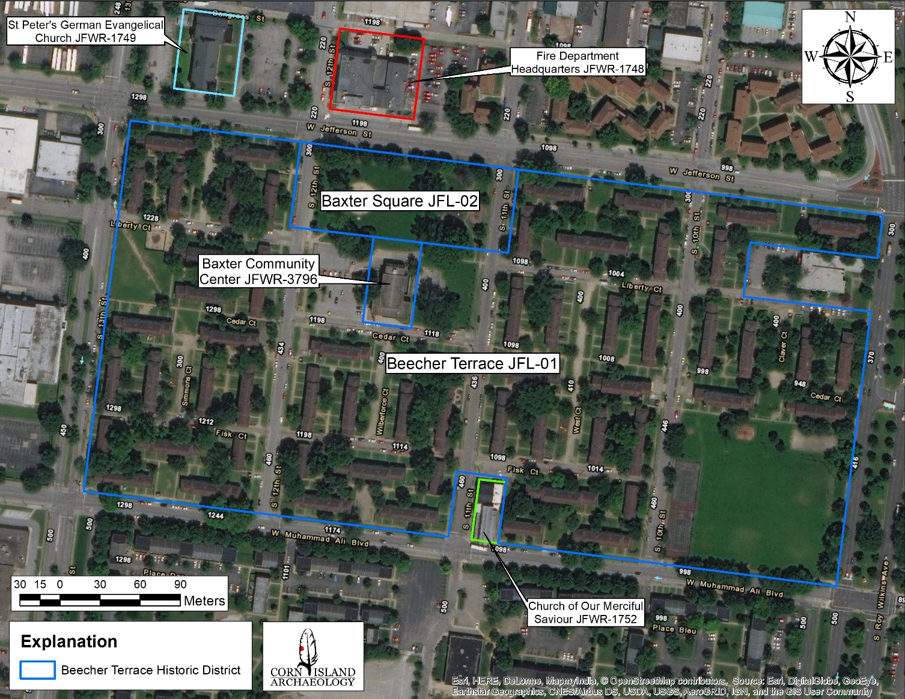
Notes:
One New Historic District-Beecher Terrace Historic District
Beecher Terrace Complex
Baxter Community Center
Baxter Square Park
Two Archaeological Sites
Baxter Square Park
Beecher Terrace
Three Historic Buildings
Fire Department Headquarters
St. Peters Church
Merciful Savior Church
Fire Department Headquarters-JFWR-11748 at the top of the map
St. Peters Church-JFWR-1749-NW corner
Merciful Savior Church-JFWR-1752-At the bottom of the map

Slide 13
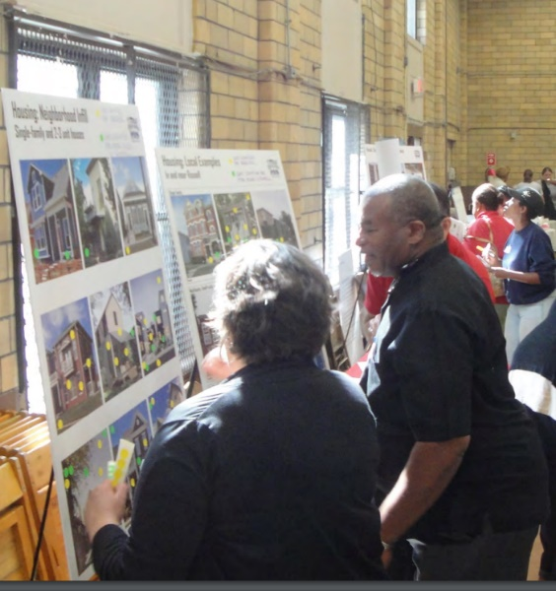
Project CONTACTS
RELOCATION BENEFITS - CATHY HEAD, (502) 569-3479
CHOICE NEIGHBORHOODS - KATHLEEN ONEIL, (502) 569-3461
EVENT CALENDAR – CHLOE QUIROGO, (502) 569-3454
RUSSELL NEIGHBORHOOD – JEANA DUNLAP, (502) 574-4140
HISTORIC PRESERVATION – CYNTHIA ELMORE, (502) 574-2868
Write us at www.visionrussell.com

