Slide 1
Section 106 Consulting Parties Meeting
April 12, 2018
Tim Barry, Louisville Metro Housing Authority
Gretchen Milliken, Louisville Metro Government
Jeana Dunlap, Louisville Metro Government
Cynthia Elmore, Louisville Metro Government
Cinder miller, gray & Pape, cultural resources

Slide 2
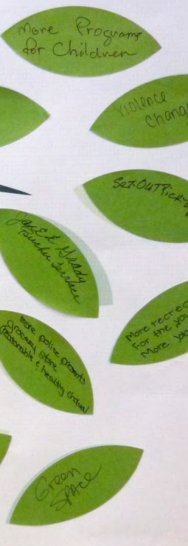
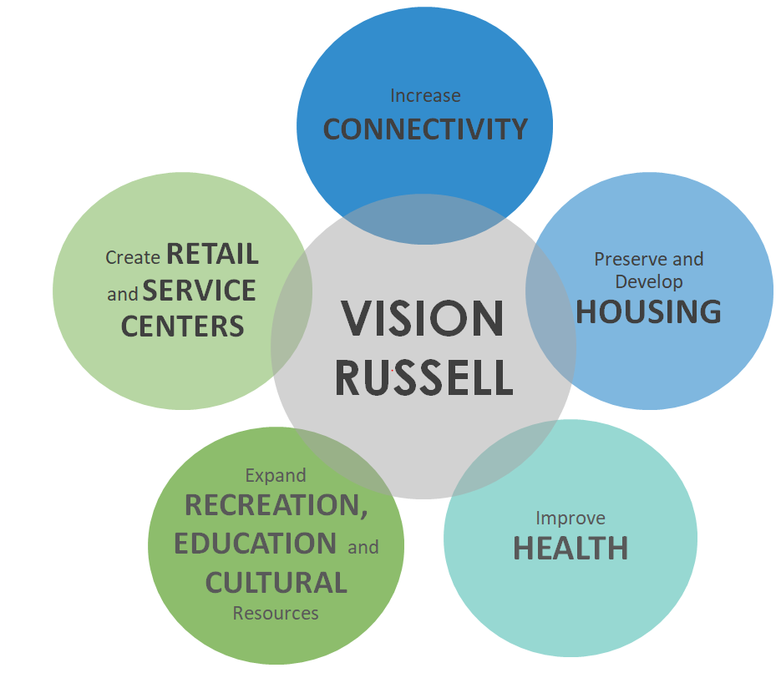
Project Overview
People
Housing
Education
Neighborhood
Notes:
Has included continuous community engagement

Slide 3
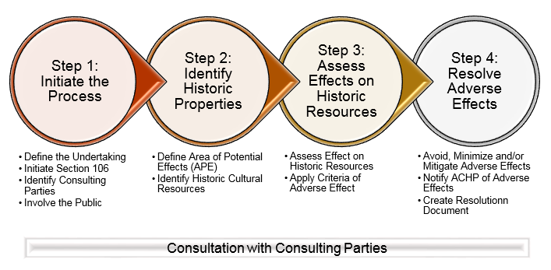
Status of Section 106 for Beecher Terrace Project
Project has been determined to be an Undertaking by the Louisville Metro Government, acting as the Responsible Entity
Step 1: Initiate the Project-Process initiated in December. Ongoing.
Step 2: Identify and Evaluate historic properties-Archaeological and Architectural Surveys have been completed.
Step 3: Assess effects of the
Undertaking on historic properties-
Project will have an Adverse Effect
Step 4: Resolve any adverse effects-
Developing a PA to resolve effects
Notes:
These are all the steps! Where are we in this process for the BT project?
Steps 1 and 2- Have identified additional consulting parties. All identification reports submitted. Comment Period on Above Ground resource report is closed. Archaeology report comment period closed on April 2.
Step 3-LMG has already determined and SHPO has already concurred that the project will have an adverse effect on historic properties. BT Historic District will be adversely effected. LMG has determined that the project will have no adverse effect on any other resources.
Step 4- Metro knows that there will be many effects that they cannot define yet. Thus, they are developing a Programmatic Agreement to help resolve the effects now and into the future. PA has been circulated, comment period on the PA closed April 6. Received comments from KHC and ACHP.
Will discuss mitigation options in this meeting

Slide 4
Area of Potential Effect
Notes:
Project will have an adverse effect on the Beecher Terrace complex during Stage I. There will be no adverse effect on any other resources.

Slide 5
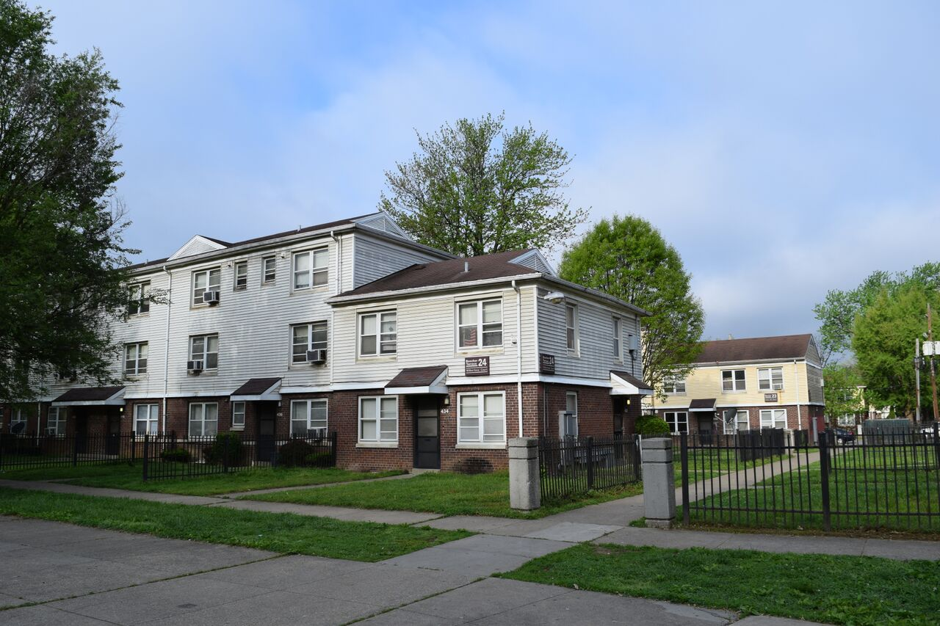
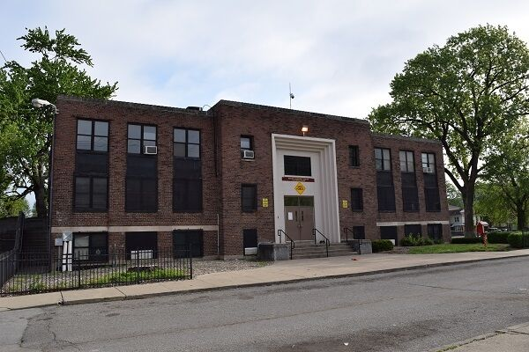
Beecher Terrace Historic District
Public Residential Units
Baxter Community Center
Notes:
Includes all of BT, Baxter Community Center, and Baxter Park. Important because of the association with the BT neighborhood and community. Community center has a long history as a gathering place in the neighborhood. What are the elements of this historic place that are important to the community historically and why? What are the elements that should be celebrated and commemorated as we move forward with the project?

Slide 6
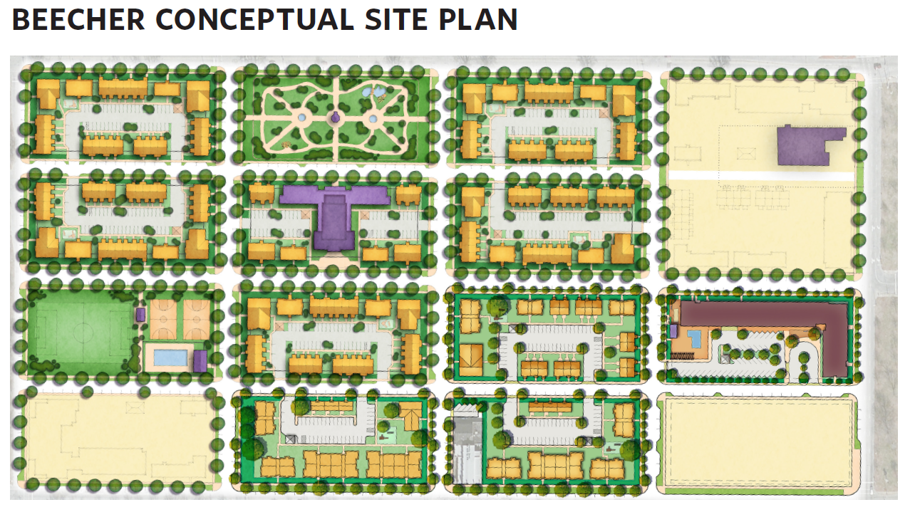

Phase I of Project
Lifelong Wellness
Building
- 4 Stories
- 117 Senior Units
- Management Offices
- On-Site Amenities
Phase I
Conceptual Site Plan
Notes:
Phase I on Construction includes-Lifelong Wellness Center and Amenities, A return to the original street grid, and associated amenities such as lighting, curbs, and infrastructure.

Slide 7
Notes:
Demolition to begin this summer

Slide 8
Life-long Wellness Building

Slide 9
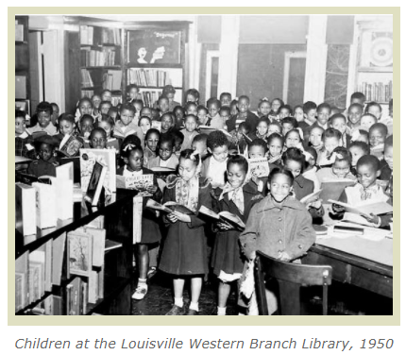
Resolution of Effects Stage I
Resolving effects related to development at this Stage. Primary impact is demolition of Beecher Terrace, focus on that effect first.
Louisville Story Program
Darcy Thompson
Western Archives
Natalie Woods
Beecher Terrace Documentary
Lavel White
Others?

Slide 10

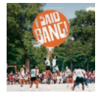
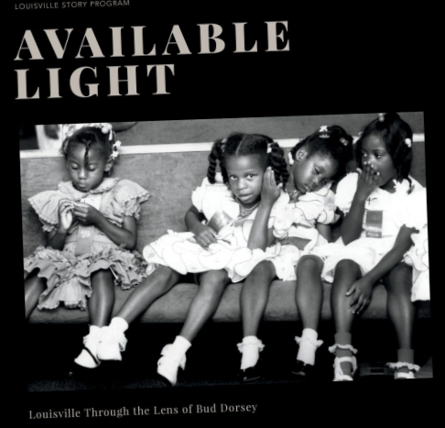

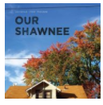
Resolution of Effects Stage I

Slide 11
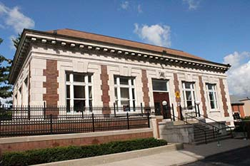
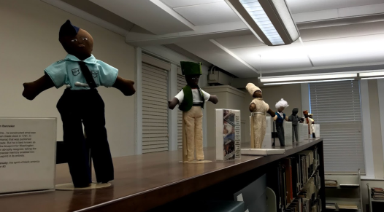
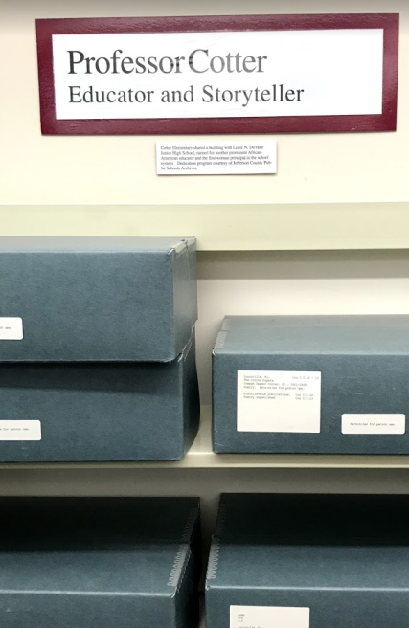
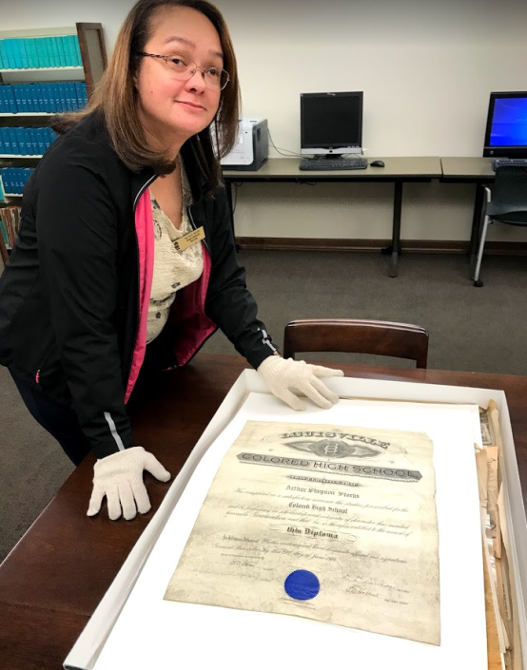
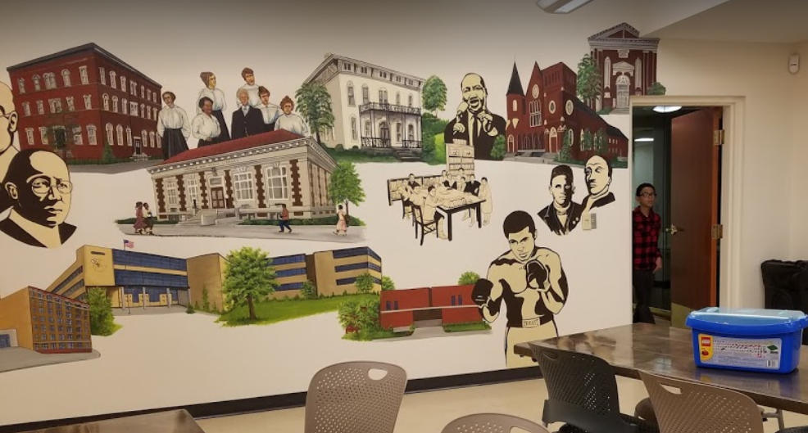
Resolution of Effects Stage I
Western Library Historic Archives

Slide 12
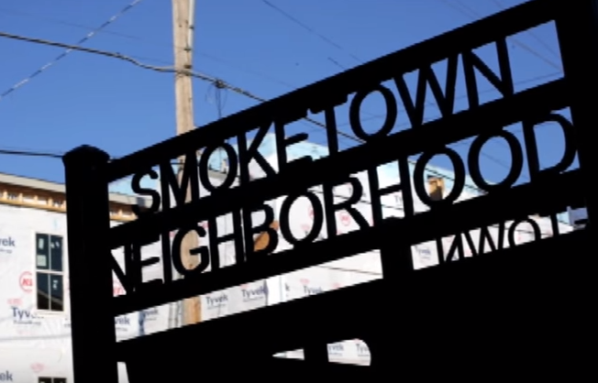
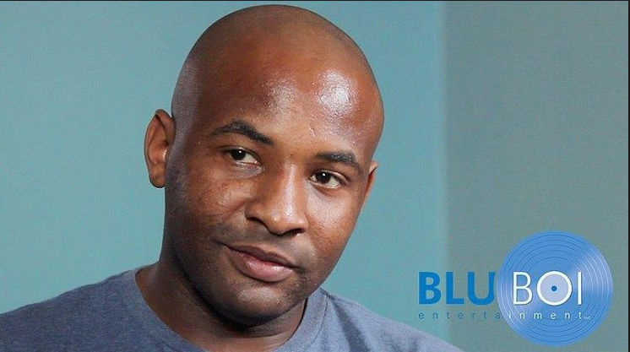
Resolution of Effects Stage I
Beecher Terrace Documentary
More Than Bricks & Mortar: Smoketown, A New Beginning

Slide 13
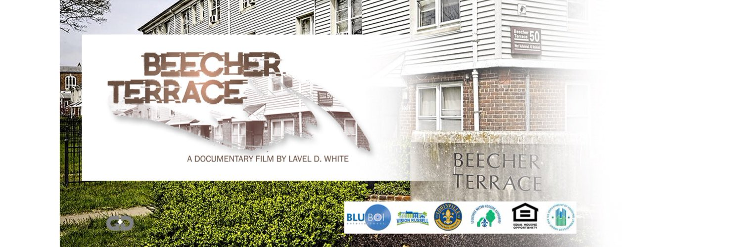
Documentary Film

Slide 14
Project Time Line
Stage I
Section 106 Compliance Phase 1 - 3
Demolition Phase 1 - 3
Construction Phase 1 - 7
Relocation Phase 1 - 3
Known Impacts and Effects As of Jan. 1 2018
  Phase I of Project Design and Construction
  Phase I, II, and III of Demolition
  Phase I, II, and III of Section 106 Compliance

Slide 15
Phase 2 Effects
No Adverse Effect-No changes to Baxter Park or other resources adjacent to the facility

Slide 16

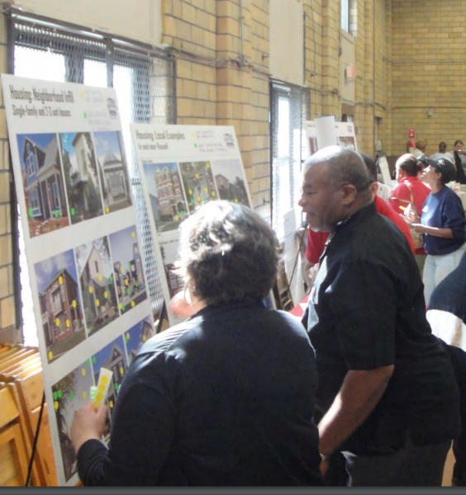

Project CONTACTS
RELOCATION BENEFITS - CATHY HEAD, (502) 569-3479
CHOICE NEIGHBORHOODS - KATHLEEN ONEIL, (502) 569-3461
EVENT CALENDAR – CHLOE QUIROGO, (502) 569-3454
RUSSELL NEIGHBORHOOD – JEANA DUNLAP, (502) 574-4140
HISTORIC PRESERVATION – CYNTHIA ELMORE, (502) 574-2868
Write us at www.visionrussell.com

